Slide 1
CSCI 570 Exam 1 Review

Slide 2
Heaps and MST
Sanjeev

Slide 3
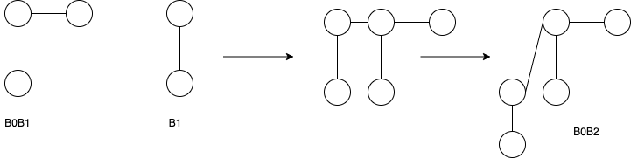
Merge in Binomial heaps
11 + 10 = 101 → B2B0

Slide 4
Question 1
Merge two binomial heaps
B0B1B2B4 and B1B4
What would be they sizes of individual component trees?

Slide 5
B0B1B2B4 → 10111
B1B4 → 10010
Perform Binary addition
Result → 101001
Heap after merging → B5B3B0

Slide 6
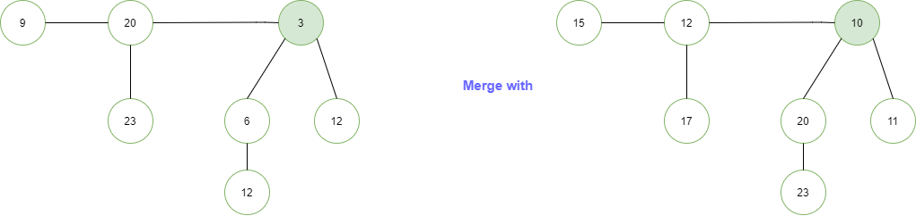
Question 2
14

Slide 7
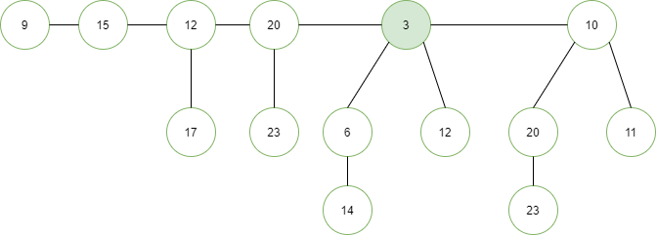
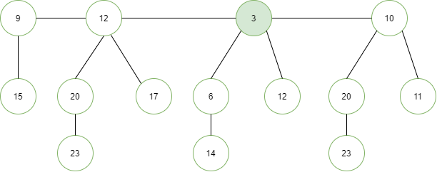

Slide 8
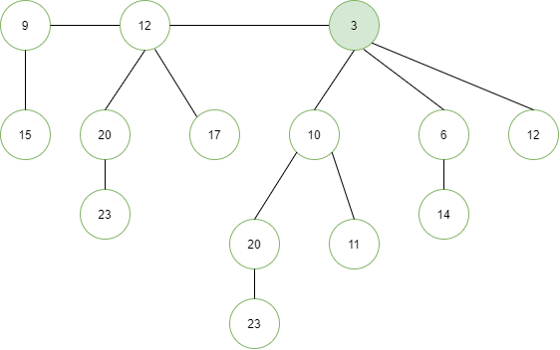

Slide 9
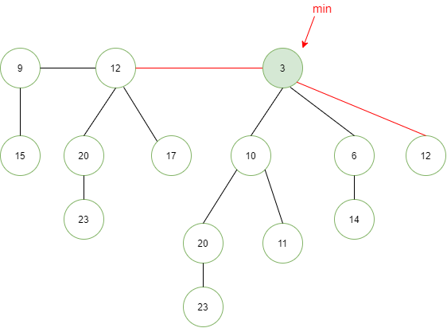
deleteMin()

Slide 10
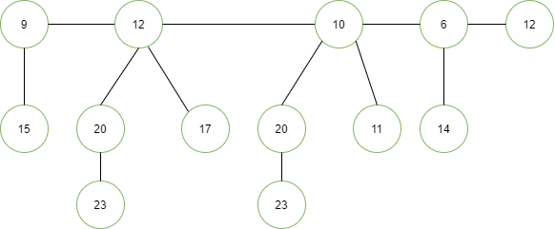

Slide 11
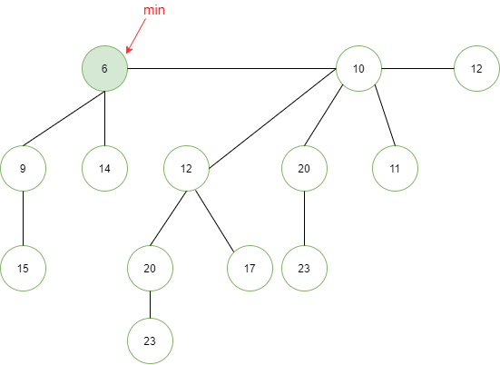

Slide 12
Meeting Scheduler
There are N meetings to be scheduled. A company wants to make sure the first K meetings get scheduled on-time. Rest of the meetings can get delayed. Find the least number of rooms required to schedule the first K meetings exactly at their starting time. You are given start time S_i and end time E_i of each meeting.
Can you do it in O(NlogN) complexity?
Can you do better? O(N + KlogN)?
Which data structure do you think would be the best?

Slide 13
Solution:
Create pairs of <timestamp, startTimeBool> true if start time, else false
Create a MaxHeap of all the pairs

Slide 14
Create pairs of <timestamp, startTimeBool> true if start time, else false
Create a MaxHeap of all the pairs
Realize its not MaxHeap but the one which is better here is MinHeap!!
Keep a variable to track the maxRoomCount, numMeetings
Pop the pairs: Increment/Decrement the curRoomCount based on the bool
When numMeetings reach K, we stop and return maxRoomCount
Complexity: O(N + K log N)

Slide 15
[T/F] The smallest element in a binary max-heap of size n can be found with at most n/2 comparisons.

Slide 16
[T/F] The smallest element in a binary max-heap of size n can be found with at most n/2 comparisons.
True. In a max heap, the smallest element is always present at a leaf node. So we need to check for all leaf nodes for the minimum value → how many leaf nodes are there?
ceil(n/2) leaf nodes. → Therefore, we will only have to do at most n/2 comparisons.

Slide 17
MST 1
[T/F] If all edge weights of a given graph is the same, then every spanning tree of that graph is minimum.

Slide 18
[T/F] If all edge weights of a given graph is the same, then every spanning tree of that graph is minimum.
True.
Spanning tree: Any tree that covers all nodes of a graph is called a spanning tree.

Slide 19
MST 2
[T/F] If the weight of each edge in a connected graph is distinct, then the graph contains exactly one unique minimum spanning tree.

Slide 20
[T/F] If the weight of each edge in a connected graph is distinct, then the graph contains exactly one unique minimum spanning tree.
True.
Proof: Suppose two MSTs T1 and T2 of G,
E = set of edges that is in either T1 or T2 but not both.
e is the min edge in E.
Suppose e is not in T2. Adding e to T2 creates a cycle. Then in this cycle, at least one edge, say f, is not in T1. Since e is te min edge in E, then w(e) <= w(f). And all edges have distinct weights, w(e) < w(f). Replacing f with e results in a new spanning tree with less weight than T1 and T2. Therefore, contradiction.

Slide 21
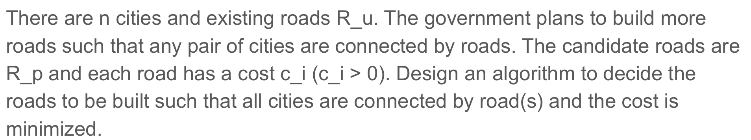
MST 3

Slide 22
MST 3
1: Construct a graph with n nodes.
2: Add R_u to the graph and set edge weight to be 0.
3: Add R_p to the graph and set edge weights to be the cost.
4: Run MST algorithm, return roads that are in both R_p and MST.
1: Get connected components of the graph with R_u.
2: Merge nodes and edges.
3: Add R_p, run MST.

Slide 23
Stable Matching
Xubin Zhang

Slide 24
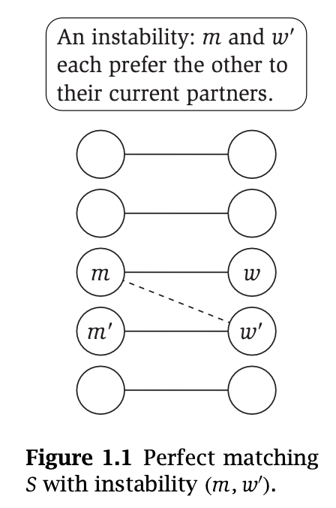
Stable Matching
Given two sets M and W
Each member of one set has a strict preference order for each member of the other set
Our goal is a stable matching
Perfect Matching: each member of M and each member of W appear in exactly one pair (m, w)
No instabilities: where in pairs (m, w) and (m’, w’)
m prefers w’ to w’
w’ prefers m to m’

Slide 25
Gale-Shapley Algorithm
Initialize all m in M and w in W to be free
while there is a man m that is free and has not proposed to every woman:
Let w be m’s highest ranking women he has not proposed to
If w is free or prefers m to her current partner m’:
engage (m, w)
m’ (if exists) becomes free
Runtime: O(n²)

Slide 26
Gale-Shapley Properties
GS will always correctly return a stable matching
The proposing side receives their best valid stable matches
The accept/reject side receives their worst valid stable matches
Gale-Shapley algorithm is a greedy algorithm

Slide 27
True or False
There are at least 2 distinct solutions to the stable matching problem: one that is preferred by men and one that is preferred by women.
False:
Consider the example: two men X and Y; two women A and B.
Preference list (decreasing order):
X’s list: A, B; A’s list: X, Y;
Y’s list: A, B; B’s list: X, Y.
The matching is unique: X-A and Y-B.

Slide 28
Prove that, if all men have the same list of preferences, there can be only one stable matching.
4 steps:
1. Prove that the first woman in the ranking has to be paired with her first choice in any stable pairing
the first woman in the ranking has to be paired with her first choice in any stable pairing, otherwise she and her first choice would form an instability since her first choice prefers her over any other woman

Slide 29
2. Prove that the second woman has to be paired with her first choice if that choice is not the same as the first woman’s first choice. Otherwise she has to be paired with her second choice.
If the first and second women have different first choices, then the second woman must be matched to her first choice. Otherwise she and her first choice would form an instability (since her first choice is not matched to the first woman, he would prefer the second woman over his current match).
If the first choices are the same, then the second woman must be paired with her second choice, otherwise she and her second choice would form an instability (neither of them are matched to their first choices, and they are each other’s second choice).

Slide 30
3. Continuing this way, assume that we have determined the pairs for the first k−1 women in the ranking. Who should the k-th woman be paired with?
The k-th woman should be paired with the first man on her list who has not been matched yet (with the first k − 1 women). If she’s not matched to him, they would form an instability. This is because the man would have to be matched to a woman ranked worse than k, so she would prefer the k-th woman over his current partner, and the k-th woman obviously prefers him to whoever she’s matched with.
4. Prove that there is a unique stable pairing.
In the previous parts, we saw that for each woman, given the pairs for the lower-ranked women, her pair would be determined uniquely. So there is only one stable pairing.
This can be stated and proved more rigorously using induction. Namely that there is a unique pairing for the first k women, assuming stability. An induction on k would prove this.

Slide 31
Shortest Path
Nan Xu

Slide 32
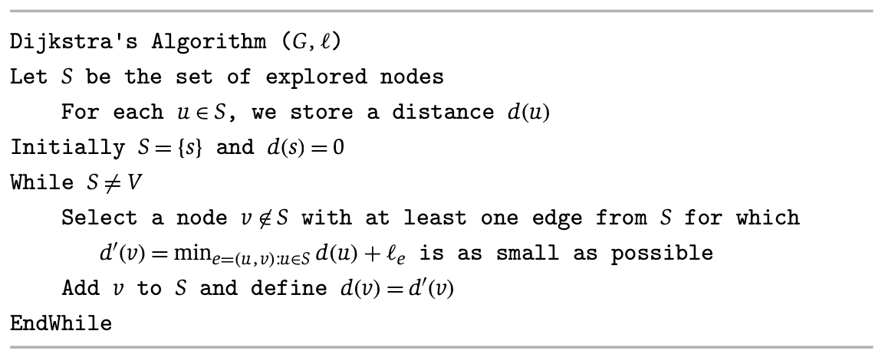
Recap: Dijkstra’s Algorithm
Step 1
3
y
s->u=1
u
1
1
1
d(s)=0
4
s->x=4
s
x
2
2
Set S:
Nodes already explored
2
v
s->v=2
3
z

Slide 33
Recap of Dijkstra’s Algorithm
s->u->y=4
Step 2
3
y
d(u)=1
u
1
1
1
d(s)=0
s->u->x=2
s->x=4
s
4
x
2
2
Set S:
Nodes already explored
2
v
s->v=2
3
z

Slide 34
Recap of Dijkstra’s Algorithm
Step 3
s->u->y=4
3
y
d(u)=1
u
1
1
1
d(s)=0
s->u->x=2
s->x=4
s->v->x=4
s
4
x
2
2
Set S:
Nodes already explored
2
v
d(v)=2
s->v->z=5
3
z

Slide 35
Recap of Dijkstra’s Algorithm
Step 4
s->u->y=4
s->u->x->y=3
3
y
d(u)=1
u
1
1
1
d(s)=0
s
4
x
d(x)=2
2
2
Set S:
Nodes already explored
2
v
d(v)=2
s->v->z=5
s->u->x->z=4
3
z

Slide 36
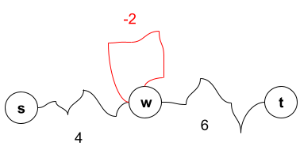
NOTE: Negative Weights - Negative Cycles
Negative cycles: if some cycle has a negative total cost, we can make the s-t path as low cost as we want
s->w->t: 4+6=10
s->w (cycle once)->t: 4-2+6=8
s->w (cycle twice)->t: 4-2*2+6=6
…
s->w (cycle N times)->t: 4-2*N+6=-∞, when N->∞

Slide 37
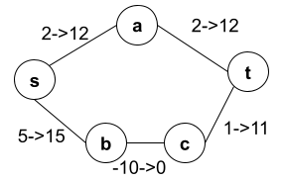
NOTE: Negative Weights - Solve with a Big Number?
Adding a large number M to each edge DOES NOT work
New cost of path P: M*len(P)+old_cost(P)
When M is big, the number of hops (path length) will dominate rather than old path cost
Before: s-b-c-t (-4) is shorter than s-a-t (4)
After adding 10 to all edges: s-a-t (24) is shorter than s-b-c-t (26)
Solution: Bellman-Ford in Dynamic Programming Section

Slide 38
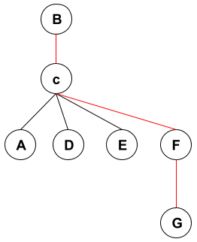
Problem I
The diameter of a graph is the maximum of the shortest paths’ lengths between all pairs of nodes in graph G.
Design an algorithm which computes the diameter of a connected, undirected, unweighted graph in O(mn) time, and explain why it has that runtime.
Diameter of this graph is: 3

Slide 39
Solution I
Unweighted graph => BFS can be used for shortest path search for each source node in O(m+n)
For one source node s, report the maximum layer reached
Repeat BFS for each node in O(n)
Total time complexity: O(n(m+n))
Connected graph, the number of edges are at least n-1, at most n(n-1)/2, hence n=O(m)
=> O(m+n) is O(m)
total time complexity: O(nm)

Slide 40
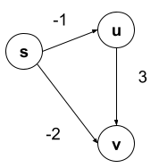
Problem II:
Dijkstra’s algorithm works correctly on a directed acyclic graph even when there are negative-weight edges.
TRUE or FALSE

Slide 41
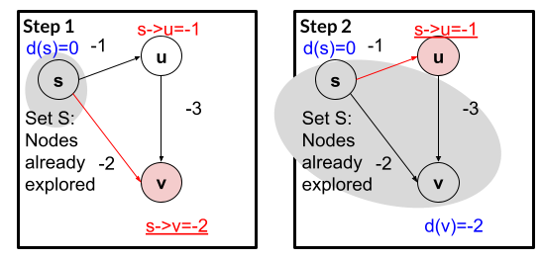
Solution II
False
Dijkstra’s algorithm: d(v)=-2
Actual shortest path: s-u-v, with cost -4

Slide 42
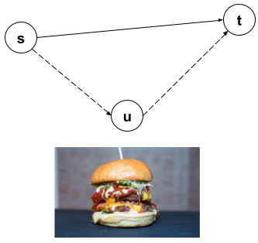
Problem III
Suppose that you want to get from vertex s to vertex t in a connected undirected graph G = (V; E) with positive edge costs, but you would like to stop by vertex u (imagine that there are free burgers at u) if it is possible to do so without increasing the length of your path by more than a factor of ɑ
Describe an efficient algorithm in O( |E| log |V| ) time that would determine an optimal s-t path given your preference for stopping at u along the way if doing so is not prohibitively costly. (In other words, your algorithm should either return the shortest path from s to t, or the shortest path from s to t containing u, depending on the situation.)

Slide 43
Solution III
Positive edges => Dijkstra’s algorithm for shortest path from source node s, and from source node u
shortest path from s => we know d_{s}(t) and d_{s}(u)
Shortest path from u => we know d_{u}(t)
Compare d_{s}(u) + d_{u}(t) and ɑ*d_{s}(t)
If d_{s}(u) + d_{u}(t) <= ɑ*d_{s}(t), stop by u for burger!
If d_{s}(u) + d_{u}(t) > ɑ*d_{s}(t), go directly from s to t
Time complexity
Connected graph: |V|=O(|E|)
Running Dijkstra’s algorithm twice:
Binary heap: O((|V| +|E|) log |V|) => O( |E| log |V| )
Fibonacci heap: O(|E|+|V|log|V|) => O( |E| log |V|)

Slide 44
CSCI 570 Exam 1 Review
BFS & DFS

Slide 45
Breadth First Search (BFS)
BFS is a graph search algorithm, an algorithm for exploring a graph G=(V,E).
BFS starts at a vertex s and explores outwards, visiting all nodes distance 1 from s, then all nodes distance 2 from s, and so on.
BFS can find a path between two vertices s and t, if such a path exists.
BFS finds the shortest path between s and t if the graph is unweighted.
BFS is implemented using a queue (FIFO).
The worst-case runtime of BFS is O(|V | + |E |).

Slide 46
BFS Tree
A graph search algorithm induces a search tree T⊆G, with root s and edges u→v, where the first time the algorithm explored v was by traversing the edge (u,v) in G.
(3.3) For each j ≥ 1, layer L_{j} produced by BFS consists of all nodes at distance exactly j from s. There is a path from s to t if and only if t appears in some layer.

Slide 47
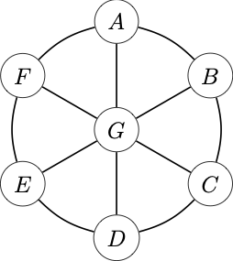
Problem 1
List the order in which vertices are visited when executing BFS starting from vertex E and breaking ties alphabetically.
Answer: E, D, F, G, C, A, B

Slide 48
Depth First Search (DFS)
DFS is also a graph search algorithm.
DFS starts at a vertex s and explores by walking around the graph, backtracking when it hits a dead-end.
DFS can find a path between two vertices s and t, if such a path exists.
DFS is implemented using a stack (LIFO).
The worst-case runtime of DFS is also O(|V | + |E |).

Slide 49
DFS Tree
(3.7) Let T be a depth-first search tree, let x and y be nodes in T, and let (x, y) be an edge of G that is not an edge of T. Then one of x or y is an ancestor of the other.

Slide 50
Problem 2
List the order in which vertices are visited when executing DFS starting from vertex E and breaking ties alphabetically.
Answer: E, D, C, B, A, F, G

Slide 51
BFS v. DFS
Both BFS and DFS can find a path from s to t.
Both BFS and DFS can find the number of connected components in G.
Both run in time O(|V | + |E |).
BFS is implemented using a queue (FIFO). DFS is implemented using a stack (LIFO).
BFS can find shortest paths in unweighted graphs.

Slide 52
Problem 3
Let G=(V,E) be an unweighted undirected graph, and let s, t be vertices in G. Describe an algorithm for finding the shortest path from s to t that has a length that is a multiple of 10.
Answer: Construct a graph G’=(V’, E’) with 10 vertices v₀, …, v₉ for each vertex v in G. Draw a directed edge between vertices (u_{i},v_{i+1%10}) for each edge {u,v} in E. Run BFS or DFS on G’ to find a path p’ from s₀ to t₀. Then, to construct a path p in G, for each vertex v_{i} in p’, add v to p.
Note G’ has O(10n) vertices and O(10m) edges. Therefore, running BFS or DFS on G’ takes time O(n + m).

Slide 53
CSCI 570 Exam 1 Review
DIVIDE AND CONQUER

Slide 54
Problem 1
Given a sorted array of distinct integers A[1, …, n]. Decide whether there is an index ‘i’ for which A[i] = i.
Describe an efficient divide and conquer algorithm for this problem.
Explain the time complexity.

Slide 55
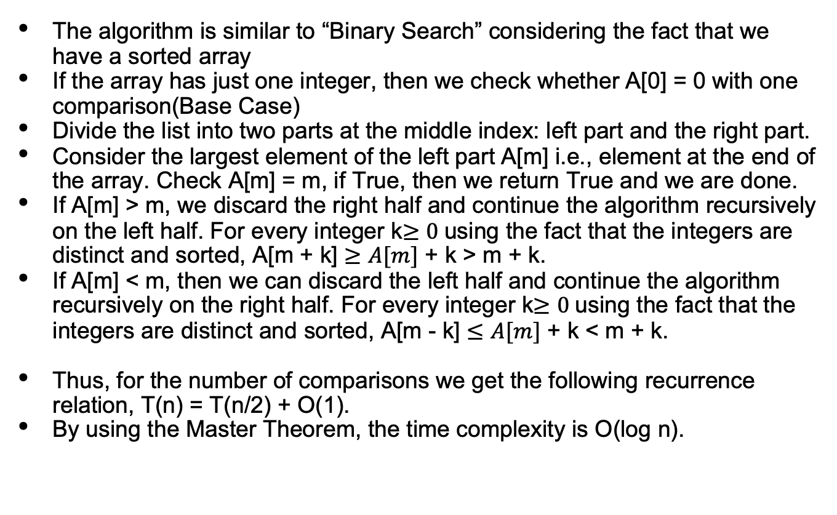
Solution

Slide 56
Problem 2
A polygon is called convex if all of its internal angles are less than 180º and none of the edges cross each other. We represent a convex polygon in the form of a coordinate pair (x,y). Consider V[1] is the vertex with the least x coordinate and that the vertices V[1], V[2], …, V[n] are ordered counter-clockwise. Assuming that the x and y coordinates of the vertices are distinct:
Give a divide and conquer algorithm to find the vertex with the largest x coordinate in O(log n) time.
Give a divide and conquer algorithm to find the vertex with the largest y coordinate in O(log n) time.

Slide 57
Solution
Since V[1] is known to be the vertex with the minimum x-coordinate (leftmost point), moving counter- clockwise to complete a cycle must first increase the x-coordinates and then after reaching a maximum (rightmost point), should decrease the x-coordinate back to that of V[1]. Thus, Vx[1 : n] is a unimodal array, and so it is synonymous with detecting the location of the maximum element in the array. Algorithm: (1) If n = 1, return Vx[1]. (2) If n = 2, return max{Vx[1], Vx[2]}. (3) k = n/2 . (4) If Vx[k] > Vx[k − 1] and Vx[k] > Vx[k + 1], then return Vx[k]. (5) If Vx[k] < Vx[k − 1] then call the algorithm recursively on Vx[1 : k − 1], else call the algorithm recursively on Vx[k + 1 : n].

Slide 58
Let p denote the index at which the x-coordinate was maximized. Observe that joining V[1] and V[p] by a straight line divides the polygon into an upper half and a lower half and the vertex achieving the maximum y-coordinate must lie above this line. The counter-clockwise traversal Vy[p] → Vy[p+ 1] → · · · → Vy[n] → Vy[1] is unimodal and we need to detect the location of the maximum element of this array. So, considering the same algorithm as above with this new array [Vy[p], Vy[p + 1], . . . , Vy[n], Vy[1]] will return the vertex with the maximum y-coordinate.
The recurrence equation is T(n) ≤ T(n/2) + Θ(1). Invoking Master’s Theorem gives T(n) = O(log n).

Slide 59
CSCI 570 Exam 1 Review
Greedy
The Slides for Greedy Part are credit to Alex Wang.

Slide 60
Greedy: 2 Common Methods of Proof of Optimality
stay-ahead: an inductive method to show that for each step you take, you are always ahead of any other solution according to some metric
exchange: show that for your greedy solution, any swaps between steps/elements cannot achieve a better result
The Slides for Greedy Part are credit to Alex Wang.

Slide 61
Problem 1
For a graph G = (V, E), a vertex cover of G is a set of vertices that includes at least one endpoint of each edge of G. Assuming our graph G is a tree, find an algorithm that finds a minimum vertex cover of G.
The Slides for Greedy Part are credit to Alex Wang.

Slide 62
Solution 1
Let S be the set of vertices that will be the vertices we return. If our graph G has no vertices or only 1 vertex, return S. Otherwise, add all vertices 1 layer above all our leaf vertices in the tree to S, and remove the vertices and its adjacent edges from G, as well as the leaf vertices. Recursively apply this step until we end up with 1 or no vertices in G. Return S.
This is optimal because we have to cover the leaf edges regardless, so our cover will always either include the leaf node itself or its parent. If we include its parent, we cover just as much if not more than if we select the leaf node. The problem then reduces to a vertex cover for a subset of the original tree. This subset is smaller than the one we would have gotten from choosing the leaf node, and a vertex cover of tree is at least as large as the vertex cover of a subset of it.
The Slides for Greedy Part are credit to Alex Wang.

Slide 63
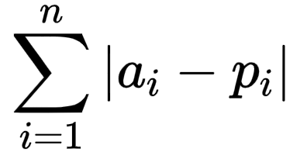
Problem 2
Given an array of distinct integers A = [a1, a2, …, an] and a sequence p of numbers p = [1, 2, …, n], rearrange the numbers in p such that is minimized.
The Slides for Greedy Part are credit to Alex Wang.

Slide 64
Solution 2
Consider 2 real numbers ai and aj, and 2 other real numbers, pi and pj, where ai < aj and pi < pj. WLOG, assume that all 4 of these numbers are distinct. There are 6 possible orderings given these constraints: ai < aj < pi < pj, ai < pi < aj < pj, ai < pi < pj < aj, pi < ai < aj < pj, pi < ai < pj < aj, and pi < pj < ai < aj. For each of these cases, we want to show that |ai - pi| + |aj - pj| ≤ |ai - pj| + |aj - pi|, which basically means that we cannot get a smaller distance if we exchange elements pi and pj. Therefore if we have ai < aj if and only if pi < pj for all i, j, we will have the minimum distance. We can store the index of the elements in A in a hashmap h. We then sort A and pair it with p, and reorder p according to indices of h. Since our algorithm produces elements ai and pi with these properties, our algorithm produces a minimum distance.
The Slides for Greedy Part are credit to Alex Wang.

Slide 65
In the previous proof, we left out details about showing
|ai - pi| + |aj - pj| ≤ |ai - pj| + |aj - pi|
for each of 6 cases. Here is an example of showing that this is true for the case for
ai < pi < aj < pj.
Define the distance between ai and pi, pi and aj, and aj and pj, as d1, d2, and d3 respectively. Then
|ai - pi| + |aj - pj| = d1 + d3 ≤ d1 + 2*d2 + d3 = |ai - pj| + |aj - pi|.
You can verify that the other cases are true as well. In the exam, there will not be this much detail involved in a proof, and if there is, we will state which parts can be skipped or assumed to be true.
The Slides for Greedy Part are credit to Alex Wang.

